Slide 1


EDA on Amazon's Data for # Sales # Product & # Customer Analysis
Capstone project using sql by lokesh todi (S7981)
Data Science bootcamp

Slide 2
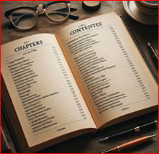
CONTENTS :
PROJECT'S problem, constraints AND GOAL
STEPS TAKEN
UNDERSTANDING AMAZON'S 'STRUCTURED' DATASET
EDA (28 BUSINESS PROBLEMS / QUESTIONS ANSWERED )
PRODUCT ANALYSIS
SALES ANALYSIS
CUSTOMER ANALYSIS
STRATEGIC BUSINESS RECOMMENDATIONS
THANK YOU with a quote to think about

Slide 3

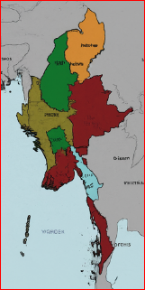
PROJECT'S PROBLEM, CONSTRAINTS, CHALLENGES & GOAL
PROBLEM – AMAZON'S REVENUE AND PROFIT LOW IN THE 3 BRANCHES OF MYANMAR
CONSTRAINTS in short run - OPERATIONAL constraints like supply-chain, LOGISTICs, INVENTORY management may impact implementation of business strategy
CHALLENGE – regulation, demand fluctuation, lead time for execution and competitor copying new strategy quickly
GOAL - GAIN INSIGHT FROM DIFFERENT FACTORS THAT AFFECT SALES, BASED ON DATA ANALYSIS OF SALES MADE IN MYANMAR:
IN 3 MONTHS
ACROSS 3 BRANCHES OF AMAZON:
MANDALAY
YANGON
NAYPYITAW
PERFORM Exploratory Data Analysis (EDA) WITH SQL ON sales data of Amazon, TO:
TO DEVELOP STRATAGIC DECISION REGARDING:
SALES STRATEGY FOR GAINING MARKET SHARE
CUSTOMER SATISFACTION & CUSTOMER LOYALTY STRATEGY FOR GAINING MARKET SHARE

Slide 4
UNDERSTANDING AMAZON'S 'STRUCTURED' DATASET #17 Columns + 3 Extra Columns Created + #1000 Rows with No NULL Values
invoice Analysis: The data includes Invoice ID, Branch, City, and Customer type, indicating transactions across different branches and customer demographics.
Product ANALYSIS: It lists various Product lines like Health and Beauty, Electronic Accessories, etc., showing the diversity of products sold.
Financial ANALYSIS: Each transaction includes Unit price, Quantity, Tax, and Total, providing insights into sales revenue and tax collection.
Operational ANALYSIS: The Date and Time of each transaction can help analyze peak sales periods and customer shopping patterns.

Slide 5
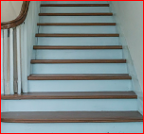
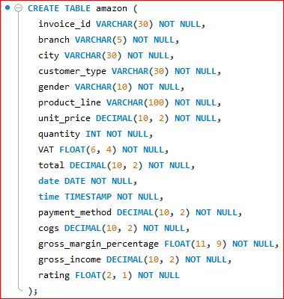



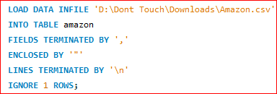
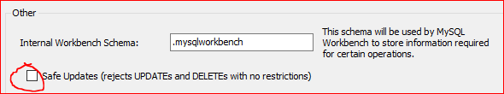
STEPS TAKEN / METHODOLOGY:
IDE & TOOL USED – MYSQL & EXCEL
DATA WRANGLING:
Build a database
Create table
insert / import data
set 'NOT NULL' for each field to filter out null value
FEATURE ENGINEERING:
Add 'new columns' by untick 'safe update':
'timeofday' to give insight of sales in the Morning, Afternoon and Evening
'dayname' that contains the extracted days of the week for transaction
'monthname' that contains the extracted months for transaction

Slide 6
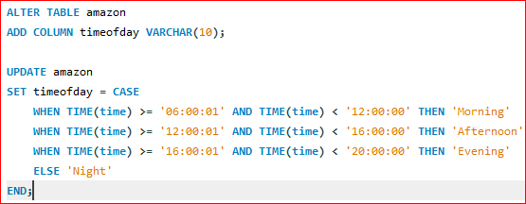
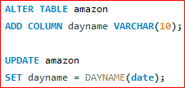

STEPS TAKEN / METHODOLOGY:
FEATURE ENGINEERING:
Add 'new columns' by untick 'safe update':
'timeofday' to give insight of sales in the Morning, Afternoon and Evening
'dayname' that contains the extracted days of the week for transaction
'monthname' that contains the extracted months for transaction

Slide 7
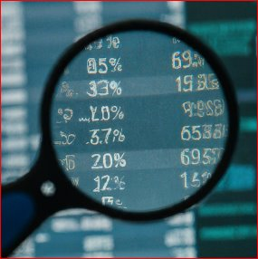
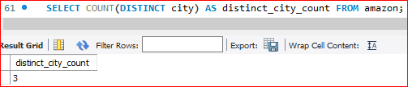
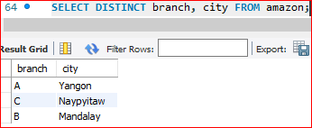
EDA(EXPLORATORY DATA ANALYSIS):
QUESTION 1: What is the count of distinct cities in the dataset?
QUESTION 2: For each branch, what is the corresponding city?

Slide 8
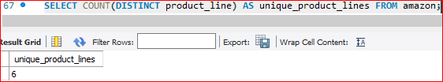
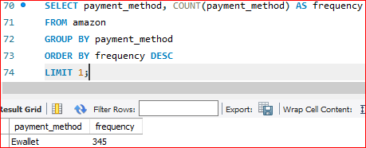
EDA(EXPLORATORY DATA ANALYSIS):
QUESTION 3: What is the count of distinct product lines in the dataset?
QUESTION 4: Which payment method occurs most frequently?

Slide 9
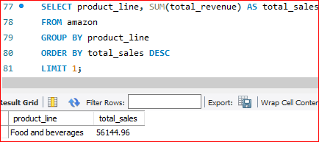
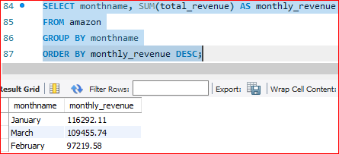
EDA(EXPLORATORY DATA ANALYSIS):
Which product line has the highest sales?
QUESTION 5: Which product line has the highest sales?
QUESTION 6: How much revenue is generated each month?

Slide 10
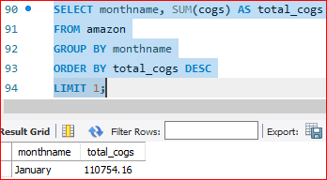
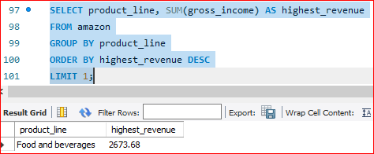
EDA(EXPLORATORY DATA ANALYSIS):
QUESTION 7: In which month did the cost of goods sold reach its peak?
QUESTION 8: Which product line generated the highest revenue?

Slide 11
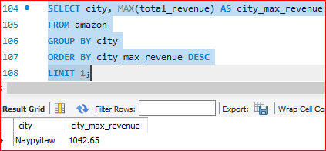
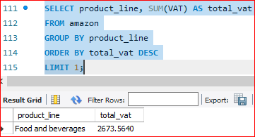
EDA(EXPLORATORY DATA ANALYSIS):
QUESTION 9: In which city was the highest revenue recorded?
QUESTION 10: Which product line incurred the highest Value Added Tax?

Slide 12
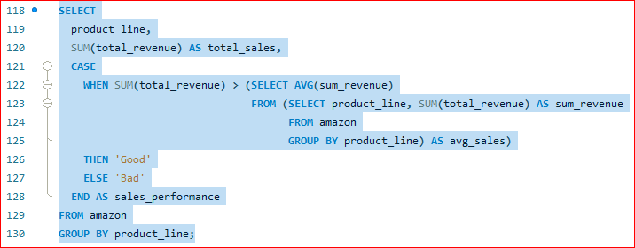
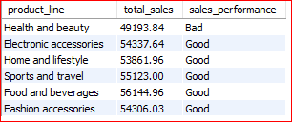
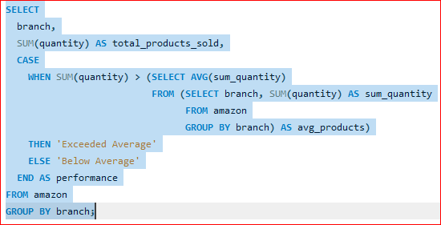

EDA(EXPLORATORY DATA ANALYSIS):
QUESTION 11: For each product line, add a column indicating "Good" if its sales are above average, otherwise "Bad."
QUESTION 12: Identify the branch that exceeded the average number of products sold.

Slide 13
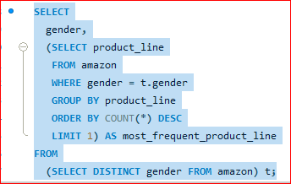

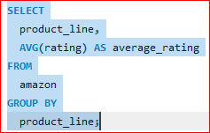
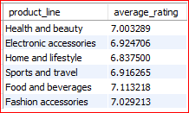
EDA(EXPLORATORY DATA ANALYSIS):
QUESTION 13: Which product line is most frequently associated with each gender?
QUESTION 14: Calculate the average rating for each product line.

Slide 14
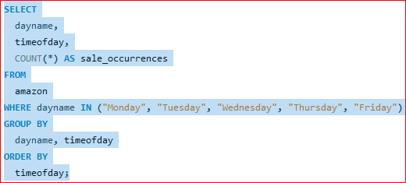
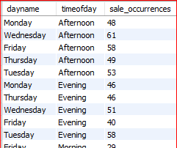
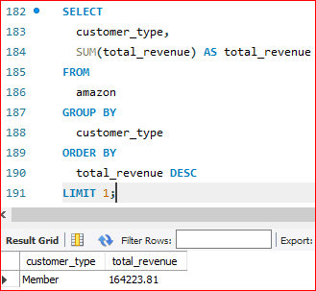
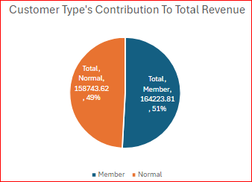
EDA(EXPLORATORY DATA ANALYSIS):
QUESTION 15: Count the sales occurrences for each time of day on every weekday.
QUESTION 16: Identify the customer type contributing the highest revenue.

Slide 15
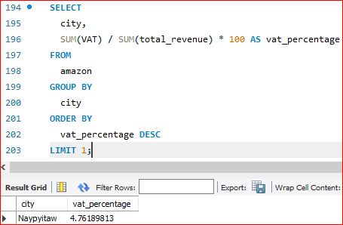
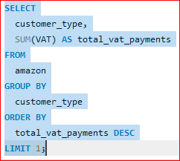

EDA(EXPLORATORY DATA ANALYSIS):
QUESTION 17: Determine the city with the highest VAT percentage.
QUESTION 18: Identify the customer type with the highest VAT payments.

Slide 16




EDA(EXPLORATORY DATA ANALYSIS):
QUESTION 19: What is the count of distinct customer types in the dataset?
QUESTION 20: What is the count of distinct payment methods in the dataset?

Slide 17
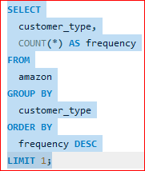

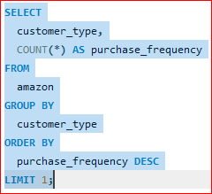

EDA(EXPLORATORY DATA ANALYSIS):
QUESTION 21: Which customer type occurs most frequently?
QUESTION 22: Identify the customer type with the highest purchase frequency.

Slide 18
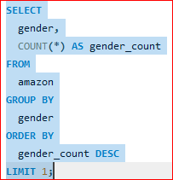

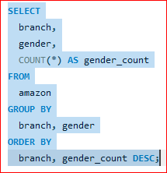
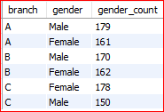
EDA(EXPLORATORY DATA ANALYSIS):
QUESTION 23: Determine the predominant gender among customers.
QUESTION 24: Examine the distribution of genders within each branch.

Slide 19
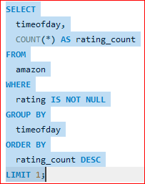
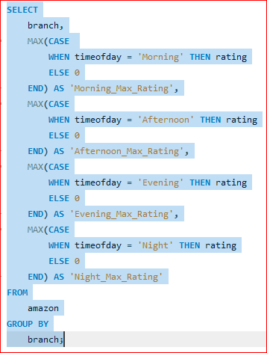


EDA(EXPLORATORY DATA ANALYSIS):
QUESTION 25: Identify the time of day when customers provide the most ratings.
QUESTION 26: Determine the
time of day with the highest
customer ratings for
each branch.

Slide 20
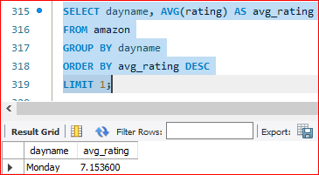
EDA(EXPLORATORY DATA ANALYSIS):
QUESTION 27: Identify the day of the week with the highest average ratings.

Slide 21
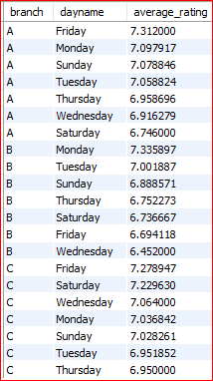

EDA(EXPLORATORY DATA ANALYSIS):
QUESTION 28: Determine the day of the week with the highest average ratings for each branch.

Slide 22

PRODUCT PORTFOLIO ANALYSIS - UNVEILING PRODUCT DYNAMICS
PRODUCT SEGMENT'S REVENUE ANALYSIS :
PRODUCT AVERAGE RATING ANALYSIS
LEVARAGE TOP SEGMENT BY SALES: Food and beverages
BOOST BOTTOM SEGMENT BY SALES: Health and beauty

Slide 23

SALES ANALYSIS - UNVEILING SALES TRENDS - MEASURE THE EFFECTIVENESS OF EACH SALES STRATEGY - eXPLORE MODIFICATIONS NEEDED TO GAIN MORE SALES
SALES BY CITY
SALES TREND BY MONTH
ALWAYS CUSTOMER 1ST for CUSTOMER SATISFACTION:
IMPROVE OPERATIONAL EFFICIENCY
CUSTOMER SERVICE FOR QUICK DISPUTE RESOLVE IN 1ST CALL
Increase operational efficiency:
INCREASE DELIVERY BOYS
INCENTIVISE DELIVERY BOYS PAYMENT BY CONNECTING WITH :
RATING AND
'NUMBER OF DELIVERY' SLAB FOR OVERACHIEVE, NORMAL, UNDERACHIEVE

Slide 24

CUSTOMER ANALYSIS - UNVEILING CUSTOMER INSIGHTS OF DIFF CUSMER SEGMENTS WITH purchase trends and the profitability of each customer segment
CUSTOMER TYPES:
A. member, normal (MEMBERS HIGHEST PURCHASERS)
b. MALE, fEMALE (FEMALE HIGHEST PURCHASERS)
GENDER PREFERENCE:
PAYMENT METHODS:

Slide 25
STRATEGIC BUSINESS RECOMMENDATIONS
Expand product list by coming up with new niche products
Variable price strategy according to TRENDS IN yearly & daily demand fluctuation
Give discount coupons as prize by playing 'spinning wheel game' daily to promote sales of slow moving products

Slide 26
THANK YOU !
"A million dollar Idea is Worthless. A million dollar execution of a 10 % Idea is Priceless." - Mark Cuban
I Leave you with THE ABOVE thought
"A million dollar idea is worthless... A million dollar execution of a 10% idea is priceless." - Mark Cuban

